Slide 1

Artificial Intelligence
CS-632
Dr. Muhammad Aqib
University Institute of Information Technology
PMAS-Arid Agriculture University Rawalpindi

Slide 2
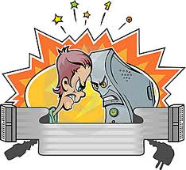
Human Intelligence vs Artificial Intelligence

Slide 3
Human Intelligence VS Artificial Intelligence
Human Intelligence
Artificial Intelligence
Intuition, Common sense, Judgement, Creativity, Beliefs etc
The ability to demonstrate their intelligence by communicating effectively
Reasoning and Critical thinking
Ability to simulate human behavior and cognitive processes
Capture and preserve human expertise
Fast Response. The ability to comprehend large amounts of data quickly.
Notes:
The important aspects of human intelligence seem to following the use of intuition, common sense, judgment, creativity, goal directedness, plausible reasoning, knowledge and beliefs.
Meaning of intelligence is not human brain’s information processing ability but the ability of humans to demonstrate their intelligence by communicating effectively.

Slide 4
Human Intelligence VS Artificial Intelligence
Human Intelligence
Artificial Intelligence
Humans are fallible
They have limited knowledge bases
Information processing of serial nature proceed very slowly in the brain as compared to computers
Humans are unable to retain large amounts of data in memory.
No “common sense”
Cannot deal with “mixed” knowledge
May have high development costs
Raise legal and ethical concerns

Slide 5
Human Intelligence VS Conventional Computing
Artificial Intelligence
Conventional Computing
AI software uses the techniques of search and pattern matching
Programmers design AI software to give the computer only the problem, not the steps necessary to solve it
Conventional computer software follow a logical series of steps to reach a conclusion
Computer programmers originally designed software that accomplished tasks by completing algorithms

Slide 6
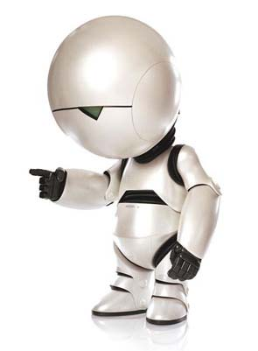
A Perspective
For Humans Intelligence is no more than TAKING a right decision at right time.
For Machines Artificial Intelligence is no more than CHOOSING a right decision at right time

Slide 7



Turing Test
A method of inquiry in AI (1950).
Determines whether a computer is thinking like a human or not.
Named after Alan Turing, a computer scientist.
Text only channel
Interrogator

Slide 8
Turing Test
Interrogator

Slide 9

Chinese Room Argument
Devised by John Searle, 1932
An argument against the possibility of true artificial intelligence.
Computers merely use syntactic rules to manipulate symbol strings, but have no understanding of meaning or semantics

Slide 10
Chinese Room Argument
Theory that human minds are computer-like computational, or information processing systems is refuted.
Instead, minds must result from biological processes.
Computers can at best simulate these biological processes.

Slide 11
AI Project (http://aitopics.org/)
Face Recognition
Object Recognition
Voice Recognition
Virtual Reality
Game Theory
Text Interpretation
NLP
FAQs
Classification Problems
Expert Systems
ITS (Algebra Word Problem)
Decision Support System
Time Table (Resource Mang.)
Promotion Builder
Planner
Logic Implementation
Machine Learning
Recommender Systems
Medicine Prescription

Slide 12
Thank You

